Slide 1
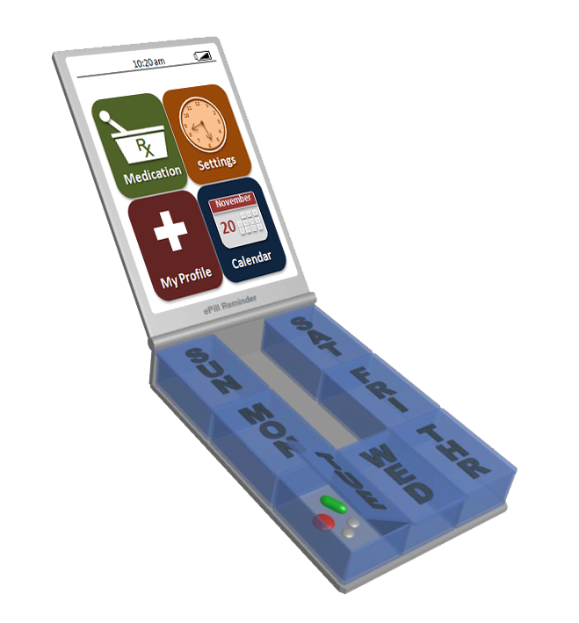
Interactive ePill Reminder
Sepideh Ansari

Slide 2
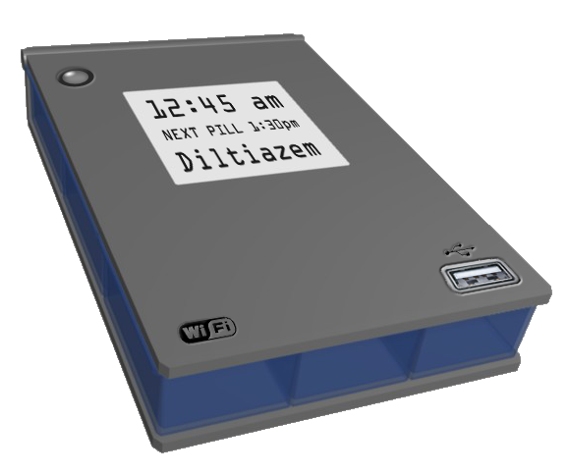
Task #1: Pharmacy Sync, Refill, Snoozing, Taking

Slide 3
10:20 am
12
11
1
10
2
R
9
3
X
8
7
5
4
6
Medication
Settings
November
20
My Profile
Calendar
You are in CVS and have dropped off your new prescription
You should prepare ePill Reminder for a USB sync with CVS system

Slide 4
10:20 am
12
11
1
10
2
R
9
3
X
8
7
5
4
6
Medication
Settings
November
20
My Profile
Calendar

Slide 5
10:20 am
Sync
Refill

Slide 6
10:20 am
Sync
Refill

Slide 7
10:20 am
Sync
Barcode
USB
Wireless

Slide 8
10:20 am
Sync
Barcode
USB
Wireless

Slide 9
10:21 am
Please insert the USB
OK

Slide 10
10:21 am
Please insert the USB
OK

Slide 11
10:21 am
Information is being transferred
Please wait …

Slide 12
10:22 am
Transfer Complete !
Start Refill

Slide 13
10:22 am
Transfer Complete !
Start Refill
You should insert the new pills in the compartments one by one

Slide 14
10:22 am
Pills to Refill 3/3
Name: Diltiazem ER
Dosage: 180 ml
Direction: Take 2 tab. M, W & F
Skip
SUN
SAT
MON
FRI
TUE
WED
THR

Slide 15
10:22 am
Pills to Refill 3/3
Name: Diltiazem ER
Dosage: 180 ml
Direction: Take 2 tab. M, W & F
Skip
SUN
SAT
MON
FRI
TUE
WED
THR

Slide 16
10:23 am
Pills to Refill 3/3
Name: Diltiazem ER
Dosage: 180 ml
Direction: Take 2 tab. M, W & F
Skip
SUN
SAT
MON
FRI
TUE
WED
THR

Slide 17
10:23 am
Pills to Refill 3/3
Name: Diltiazem ER
Dosage: 180 ml
Direction: Take 2 tab. M, W & F
Skip
SUN
SAT
MON
FRI
TUE
WED
THR

Slide 18
10:24 am
Pills to Refill 3/3
Name: Diltiazem ER
Dosage: 180 ml
Direction: Take 2 tab. M, W & F
Skip
SUN
SAT
MON
FRI
TUE
WED
THR

Slide 19
10:24 am
Pills to Refill 3/3
Name: Diltiazem ER
Dosage: 180 ml
Direction: Take 2 tab. M, W & F
Skip
SUN
SAT
MON
FRI
TUE
WED
THR

Slide 20
10:25 am
Pills to Refill 3/3
Name: Diltiazem ER
Dosage: 180 ml
Direction: Take 2 tab. M, W & F
Next
SUN
SAT
MON
FRI
TUE
WED
THR

Slide 21
10:25 am
Pills to Refill 3/3
Name: Diltiazem ER
Dosage: 180 ml
Direction: Take 2 tab. M, W & F
Next
SUN
SAT
MON
FRI
TUE
WED
THR

Slide 22
10:25 am
Pills to Refill 2/3
Name: Tacrine
Dosage: 10 ml
Direction: Take 1 tab. Mon, Sat
Skip
SUN
SAT
MON
FRI
TUE
WED
THR

Slide 23
10:25 am
Pills to Refill 2/3
Name: Tacrine
Dosage: 10 ml
Direction: Take 1 tab. Mon, Sat
Skip
SUN
SAT
MON
FRI
TUE
WED
THR

Slide 24
10:25 am
Pills to Refill 2/3
Name: Tacrine
Dosage: 10 ml
Direction: Take 1 tab. Mon, Sat
Skip
SUN
SAT
MON
FRI
TUE
WED
THR

Slide 25
10:26 am
Pills to Refill 2/3
Name: Tacrine
Dosage: 10 ml
Direction: Take 1 tab. Mon, Sat
Skip
SUN
SAT
MON
FRI
TUE
WED
THR

Slide 26
10:26 am
Pills to Refill 2/3
Name: Tacrine
Dosage: 10 ml
Direction: Take 1 tab. Mon, Sat
Next
SUN
SAT
MON
FRI
TUE
WED
THR

Slide 27
10:26 am
Pills to Refill 2/3
Name: Tacrine
Dosage: 10 ml
Direction: Take 1 tab. Mon, Sat
Next
SUN
SAT
MON
FRI
TUE
WED
THR

Slide 28
10:26 am
Pills to Refill 1/3
Name: Acetaminophen
Dosage: 15 ml
Direct.: Take 1 tab. daily
Skip
SUN
SAT
MON
FRI
TUE
WED
THR

Slide 29
10:26 am
Pills to Refill 1/3
Name: Acetaminophen
Dosage: 15 ml
Direct.: Take 1 tab. daily
Skip
SUN
SAT
MON
FRI
TUE
WED
THR

Slide 30
10:27 am
Pills to Refill 1/3
Name: Acetaminophen
Dosage: 15 ml
Direct.: Take 1 tab. daily
Skip
SUN
SAT
MON
FRI
TUE
WED
THR

Slide 31
10:27 am
Pills to Refill 1/3
Name: Acetaminophen
Dosage: 15 ml
Direct.: Take 1 tab. daily
Skip
SUN
SAT
MON
FRI
TUE
WED
THR

Slide 32
10:27 am
Pills to Refill 1/3
Name: Acetaminophen
Dosage: 15 ml
Direct.: Take 1 tab. daily
Skip
SUN
SAT
MON
FRI
TUE
WED
THR

Slide 33
10:28 am
Pills to Refill 1/3
Name: Acetaminophen
Dosage: 15 ml
Direct.: Take 1 tab. daily
Skip
SUN
SAT
MON
FRI
TUE
WED
THR

Slide 34
10:28 am
Pills to Refill 1/3
Name: Acetaminophen
Dosage: 15 ml
Direct.: Take 1 tab. daily
Skip
SUN
SAT
MON
FRI
TUE
WED
THR

Slide 35
10:28 am
Pills to Refill 1/3
Name: Acetaminophen
Dosage: 15 ml
Direct.: Take 1 tab. daily
Skip
SUN
SAT
MON
FRI
TUE
WED
THR

Slide 36
10:28 am
Pills to Refill 1/3
Name: Acetaminophen
Dosage: 15 ml
Direct.: Take 1 tab. daily
Skip
SUN
SAT
MON
FRI
TUE
WED
THR

Slide 37
10:28 am
Pills to Refill 1/3
Name: Acetaminophen
Dosage: 15 ml
Direct.: Take 1 tab. daily
Skip
SUN
SAT
MON
FRI
TUE
WED
THR

Slide 38
10:29 am
Pills to Refill 1/3
Name: Acetaminophen
Dosage: 15 ml
Direct.: Take 1 tab. daily
Skip
SUN
SAT
MON
FRI
TUE
WED
THR

Slide 39
10:29 am
Pills to Refill 1/3
Name: Acetaminophen
Dosage: 15 ml
Direct.: Take 1 tab. daily
Skip
SUN
SAT
MON
FRI
TUE
WED
THR

Slide 40
10:29 am
Pills to Refill 1/3
Name: Acetaminophen
Dosage: 15 ml
Direct.: Take 1 tab. daily
Skip
SUN
SAT
MON
FRI
TUE
WED
THR

Slide 41
10:29 am
Pills to Refill 1/3
Name: Acetaminophen
Dosage: 15 ml
Direct.: Take 1 tab. daily
Skip
SUN
SAT
MON
FRI
TUE
WED
THR

Slide 42
10:29 am
Pills to Refill 1/3
Name: Acetaminophen
Dosage: 15 ml
Direct.: Take 1 tab. daily
Next
SUN
SAT
MON
FRI
TUE
WED
THR

Slide 43
10:29 am
Pills to Refill 1/3
Name: Acetaminophen
Dosage: 15 ml
Direct.: Take 1 tab. daily
Next
SUN
SAT
MON
FRI
TUE
WED
THR

Slide 44
10:30 am
Finished
OK

Slide 45
10:30 am
Finished
OK

Slide 46
10:30 am
12:30 pm
12
11
1
10
2
R
9
3
X
8
7
5
4
6
Medication
Settings
November
20
My Profile
Calendar
Your first reminder comes when you are driving. Snooze it for 30mins.

Slide 47
12:30 pm
Take one Tacrine from Monday
Snooze
Skip
SUN
SAT
MON
FRI
TUE
WED
THR

Slide 48
12:30 pm
Take one Tacrine from Monday
Snooze
Skip
SUN
SAT
MON
FRI
TUE
WED
THR

Slide 49
12:30 pm
Take one Tacrine from Monday
Snooze
Back
10 m
40 m
20 m
50 m
30 m
60 m

Slide 50
12:30 pm
Take one Tacrine from Monday
Snooze
Back
10 m
40 m
20 m
50 m
30 m
60 m

Slide 51
12:30 pm
1:00 pm
12
11
1
10
2
R
9
3
X
8
7
5
4
6
Medication
Settings
November
20
My Profile
Calendar

Slide 52
1:30 pm
Take one Tacrine from Monday
Snooze
Skip
SUN
SAT
MON
FRI
TUE
WED
THR
You forgot to take your medication – no interaction.

Slide 53
1:30 pm
Calling Home!
Cancel
OK

Slide 54
1:31 pm
Calling Home!
Cancel
OK

Slide 55
1:31 pm
Take one Tacrine from Monday
Snooze
Skip
SUN
SAT
MON
FRI
TUE
WED
THR
After receiving the call from ePill Reminder, you will take your pill

Slide 56
1:31 pm
Take one Tacrine from Monday
SUN
SAT
MON
FRI
TUE
WED
THR

Slide 57
1:31 pm
Take one Tacrine from Monday
Next
SUN
SAT
MON
FRI
TUE
WED
THR

Slide 58
1:31 pm
Take one Tacrine from Monday
Next
SUN
SAT
MON
FRI
TUE
WED
THR

Slide 59
1:32 pm
Good
You have taken by average 90% of your medication on time this week
OK

Slide 60
1:32 pm
Good
You have taken by average 90% of your medication on time this week
OK

Slide 61
1:33 pm
12
11
1
10
2
R
9
3
X
8
7
5
4
6
Medication
Settings
November
20
My Profile
Calendar
END OF TASK 1

Slide 62
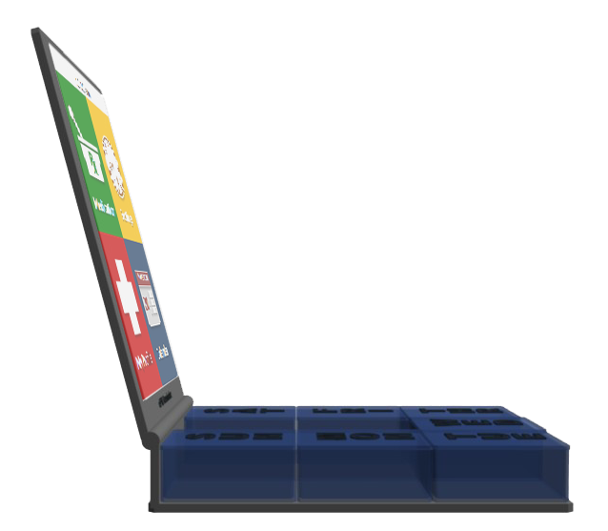
Task #2: Over the Counter, Drug-Drug Interaction

Slide 63
10:20 am
12
11
1
10
2
R
9
3
X
8
7
5
4
6
Medication
Settings
November
20
My Profile
Calendar
You are in CVS and found Zocor (over the counter)
You want to add/sync it with ePill Reminder

Slide 64
10:20 am
12
11
1
10
2
R
9
3
X
8
7
5
4
6
Medication
Settings
November
20
My Profile
Calendar

Slide 65
10:20 am
Sync
Refill

Slide 66
10:20 am
Sync
Refill

Slide 67
10:20 am
Sync
Barcode
USB
Wireless

Slide 68
10:20 am
Sync
Barcode
USB
Wireless

Slide 69
10:21 am
Please scan the barcode
OK

Slide 70
10:21 am
Please scan the barcode
OK

Slide 71
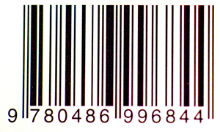
10:21 am
Barcode found
OK
Cancel

Slide 72
10:21 am
Barcode found
OK

Slide 73
10:22 am
Zocor (Simvastatin)
Name: Zocor
Dosage: 20 mgr
Indication: High Choles.
Severe Drug Interaction Detected
Diltiazem may significantly interact with Zocor – talk to your doctor or pharmacist
Cancel
Ignore/Add

Slide 74
10:22 am
Zocor (Simvastatin)
Name: Zocor
Dosage: 20 mgr
Indication: High Choles.
Severe Drug Interaction Detected
Diltiazem may significantly interact with Zocor – talk to your doctor or pharmacist
Cancel
Ignore/Add

Slide 75
10:24 am
12
11
1
10
2
R
9
3
X
8
7
5
4
6
Medication
Settings
November
20
My Profile
Calendar
Now you found Bufferin (over the counter)
You want to add/sync it with ePill Reminder

Slide 76
10:24 am
12
11
1
10
2
R
9
3
X
8
7
5
4
6
Medication
Settings
November
20
My Profile
Calendar

Slide 77
10:24 am
Sync
Refill

Slide 78
10:24 am
Sync
Refill

Slide 79
10:25 am
Sync
Barcode
USB
Wireless

Slide 80
10:25 am
Sync
Barcode
USB
Wireless

Slide 81
10:26 am
Please scan the barcode
OK

Slide 82
10:26 am
Please scan the barcode
OK

Slide 83
10:26 am
Barcode found
OK
Cancel

Slide 84
10:27 am
Barcode found
OK

Slide 85
10:27 am
Bufferin (Asprin)
Name: Bufferin
Dosage: 80 mgr
Indication: Anti Inflam.
Severe Drug Allergy Detected
Based on your profile you have allergy to aspirin. It will induce anaphylaxis shock in you.
Cancel
Ignore/Add

Slide 86
10:27 am
Bufferin (Asprin)
Name: Bufferin
Dosage: 80 mgr
Indication: Anti Inflam.
Severe Drug Allergy Detected
Based on your profile you have allergy to aspirin. It will induce anaphylaxis shock in you.
Cancel
Ignore/Add

Slide 87
10:36 am
12
11
1
10
2
R
9
3
X
8
7
5
4
6
Medication
Settings
November
20
My Profile
Calendar
Now you found Advil (over the counter)
You want to add/sync it with ePill Reminder

Slide 88
10:36 am
12
11
1
10
2
R
9
3
X
8
7
5
4
6
Medication
Settings
November
20
My Profile
Calendar

Slide 89
10:36 am
Sync
Refill

Slide 90
10:36 am
Sync
Refill

Slide 91
10:36 am
Sync
Barcode
USB
Wireless

Slide 92
10:36 am
Sync
Barcode
USB
Wireless

Slide 93
10:36 am
Please scan the barcode
OK

Slide 94
10:36 am
Please scan the barcode
OK

Slide 95
10:37 am
Barcode found
OK
Cancel

Slide 96
10:37 am
Barcode found
OK

Slide 97
10:38 am
Advil (ibuprofen)
Name: Advil
Dosage: 800 mgr
Indication: Pain Relief
Add to Schedule
See Side Effects
Cancel

Slide 98
10:38 am
Advil (ibuprofen)
Name: Advil
Dosage: 800 mgr
Indication: Pain Relief
Add to Schedule
See Side Effects
Cancel
You are planning to take one Advil on Wednesdays at 11am

Slide 99
10:38 am
Advil (ibuprofen)
Do you want to take it on Sundays
Yes
No

Slide 100
10:38 am
Advil (ibuprofen)
Do you want to take it on Sundays
Yes
No

Slide 101
10:38 am
Advil (ibuprofen)
Do you want to take it on Mondays
Yes
No

Slide 102
10:38 am
Advil (ibuprofen)
Do you want to take it on Mondays
Yes
No

Slide 103
10:38 am
Advil (ibuprofen)
Do you want to take it on Tuesdays
Yes
No

Slide 104
10:38 am
Advil (ibuprofen)
Do you want to take it on Tuesdays
Yes
No

Slide 105
10:38 am
Advil (ibuprofen)
Do you want to take it on Wednesdays
Yes
No

Slide 106
10:38 am
Advil (ibuprofen)
Do you want to take it on Wednesdays
Yes
No

Slide 107
10:38 am
Advil (ibuprofen)
What time do you want to take it on Wednesday?
10:30 am
10:45 am
11:00 am
11:15 am
11:30 am

Slide 108
10:38 am
Advil (ibuprofen)
What time do you want to take it on Wednesday?
10:30 am
10:45 am
11:00 am
11:15 am
11:30 am

Slide 109
10:39 am
Advil (ibuprofen)
How many do you want to take at 11am on Wed?
0.5 pill
1 pills
1.5 pills
2 pills
2.5 pills

Slide 110
10:39 am
Advil (ibuprofen)
How many do you want to take at 11am on Wed?
0.5 pill
1 pills
1.5 pills
2 pills
2.5 pills

Slide 111
10:39 am
Advil (ibuprofen)
Do you want to add another time on Wed?
Yes
No

Slide 112
10:39 am
Advil (ibuprofen)
Do you want to add another time on Wed?
Yes
No

Slide 113
10:39 am
Advil (ibuprofen)
Do you want to take it on Thursday
Yes
No

Slide 114
10:39 am
Advil (ibuprofen)
Do you want to take it on Thursday
Yes
No

Slide 115
10:39 am
Advil (ibuprofen)
Do you want to take it on Friday
Yes
No

Slide 116
10:39 am
Advil (ibuprofen)
Do you want to take it on Friday
Yes
No

Slide 117
10:39 am
Advil (ibuprofen)
Do you want to take it on Saturday
Yes
No

Slide 118
10:39 am
Advil (ibuprofen)
Do you want to take it on Saturday
Yes
No

Slide 119
10:40 am
Scheduling Complete!
Start Refill

Slide 120
10:40 am
Scheduling Complete!
Start Refill
You should insert the new pills in the compartments one by one

Slide 121
10:40 am
Pills to Refill 1/1
Name: Advil
Dosage: 800 mgr
Direction: Take 1.5 tabs on Weds
Skip
SUN
SAT
MON
FRI
TUE
WED
THR

Slide 122
10:41 am
Pills to Refill 1/1
Name: Advil
Dosage: 800 mgr
Direction: Take 1.5 tabs on Weds
Skip
SUN
SAT
MON
FRI
TUE
WED
THR

Slide 123
10:41 am
Pills to Refill 1/1
Name: Advil
Dosage: 800 mgr
Direction: Take 1.5 tabs on Weds
Next
SUN
SAT
MON
FRI
TUE
WED
THR

Slide 124
10:41 am
Pills to Refill 1/1
Name: Advil
Dosage: 800 mgr
Direction: Take 1.5 tabs on Weds
Next
SUN
SAT
MON
FRI
TUE
WED
THR

Slide 125
10:42 am
Finished
OK

Slide 126
10:42 am
Finished
OK

Slide 127
10:42 am
12
11
1
10
2
R
9
3
X
8
7
5
4
6
Medication
Settings
November
20
My Profile
Calendar
END OF TASK 2

